Slide 1

Project

Slide 2
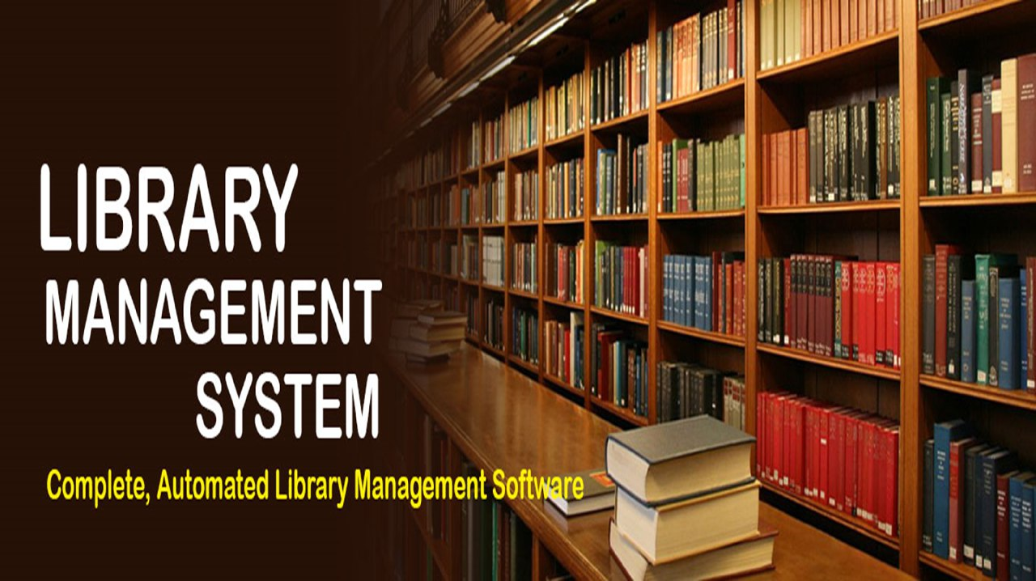


Slide 3
library Management System
Purpose/Objectives
Objective of this software project is to create a System which can host Library Management System (LMS) provide System is to efficiently organize, catalog, and manage the various resources within a library, including books, periodicals, multimedia, and other materials.
It improve overall user experience by providing a centralized and automated platform for librarians and patrons alike.

Slide 4
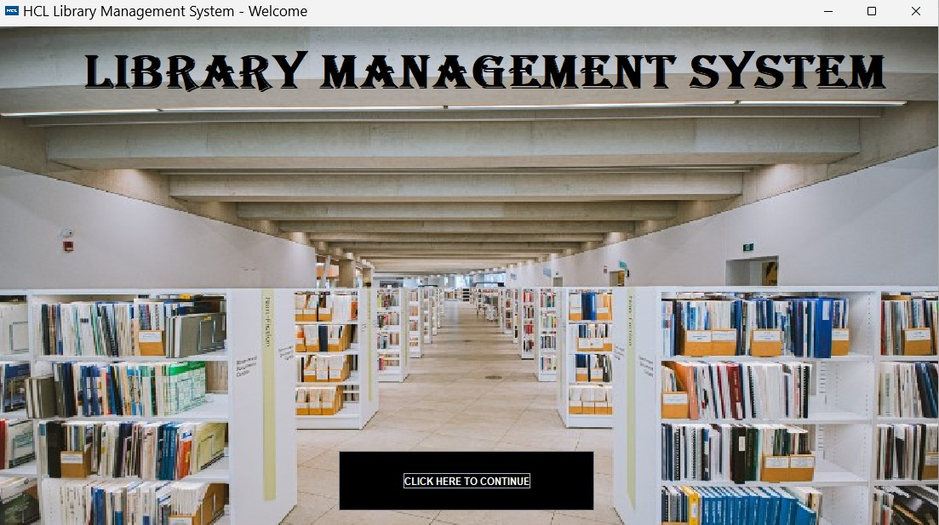
JAVA GUI BASED APPLICATION

Slide 5
TEAM MEMBERS AND ROLES
Ankit Singh (Team Leader) – Requirement Document
Anshika Gupta – Development Java
Aakash Verma - Automation Testing
Sushma – Testing Java Based
Anant Mathur – Test Cases
Priyadarshi Kumar – Test Plan

Slide 6
Introduction
Project Purpose:
The purpose of this project is to develop an Library Management System (LMS) to enhance the overall functionality of a library by providing a centralized platform for cataloging, organizing, and retrieving information about books, resources, and patrons.
Project Scope:
The scope of this project is to develop an LMS which involves designing and implementing a software system to efficiently manage and organize library resources, including books, patrons, and transactions.

Slide 7
Scope of project
FEASIBILITY STUDY:-
The feasibility study of this project has revealed the project as follows:
ORGANIZATIONAL FEASIBILITY:-
Focus on how well a proposed system its ability to streamline and enhance library operations, improving efficiency in cataloging, circulation, and resource management.
ECONOMIC FEASIBILITY:-
The project demonstrates economic feasibility by offering operational efficiency, saving time, and resulting in cost-effectiveness through streamlined processes and resource optimization. The system's ability to enhance productivity directly contributes to financial savings for the library.

Slide 8
Scope of project
TECHNICAL FEASIBILITY
Technical feasibility is confirmed by its compatibility with existing hardware and software infrastructure, seamless integration capabilities, and scalability to accommodate future growth in data and user demands.
BENEFITS OF THIS SYSTEM
This system significantly simplifies the complexities associated with library management tasks:
 By using this system we can easily maintain all book-related records, ensuring accurate and up-to-date information.
 It will reduce searching time for specific books or information.
 It can be easily handled by the person who have elementary knowledge of computer because it provides an user friendly environment. It’s hardware and software configuration is making it a cost-effective solution.
 The hardware and software requirement for this software/project are not very costly.

Slide 9
Overview
User Needs:
The LMS include efficient catalog searches simplified record management for effective library operations.
The system should be user friendly and easy to use.
Assumptions and Dependencies:
It is assumed that the LMS will be developed using Java as the programming language, JFrame and MySQL as the database.

Slide 10
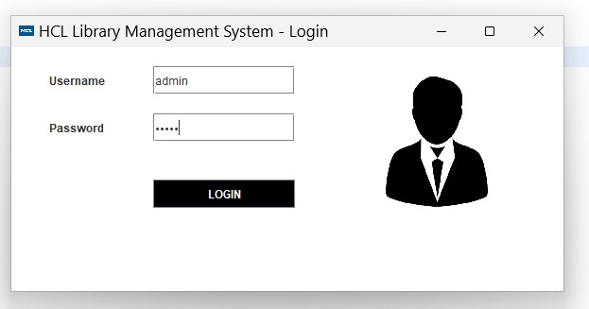
User Interface Modules
Java GUI-based application. - Login Module

Slide 11
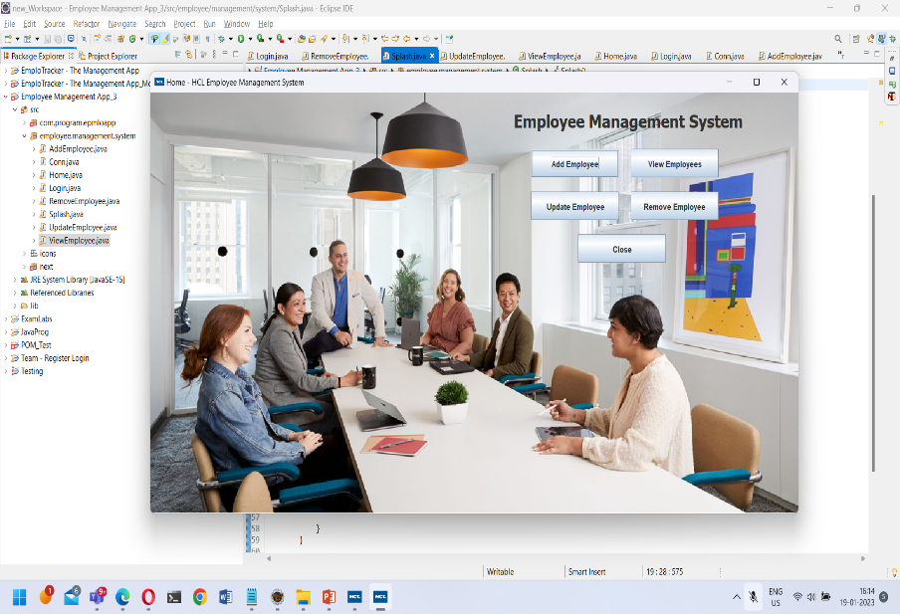
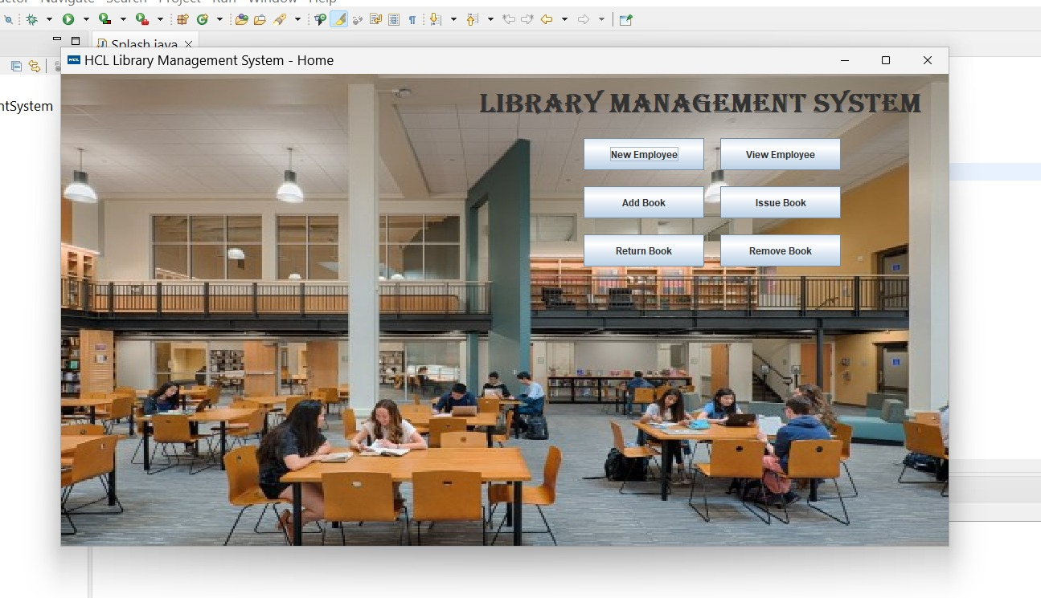
User Interface Modules
Java GUI-based application. - Home Module
In this module we perform all CURD operations

Slide 12
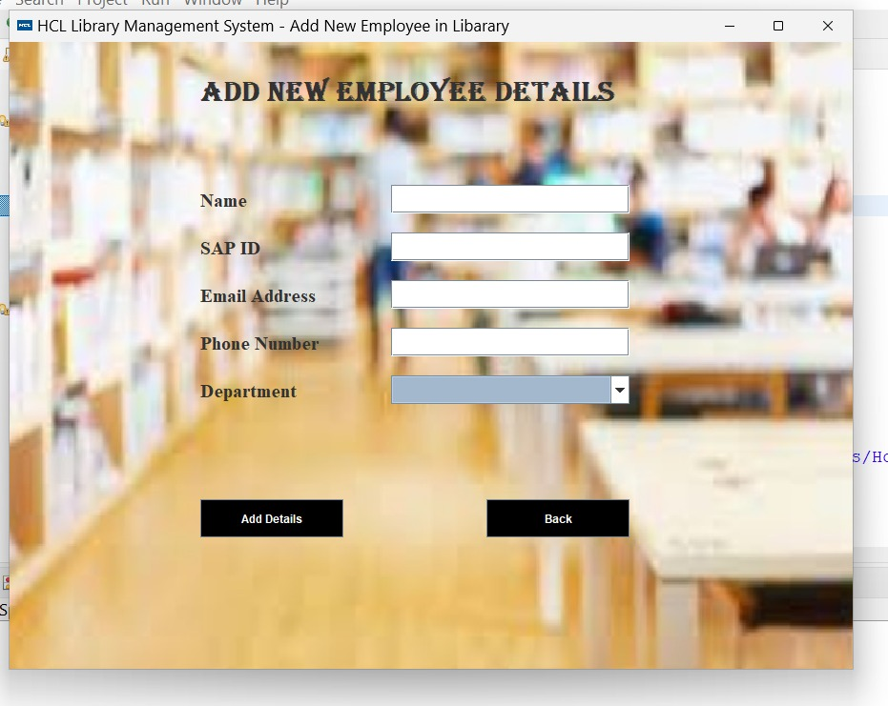
User Interface Modules
Java GUI-based application. – Add Emp. Modules
In this module we Add Details of Employee into the org. database …

Slide 13
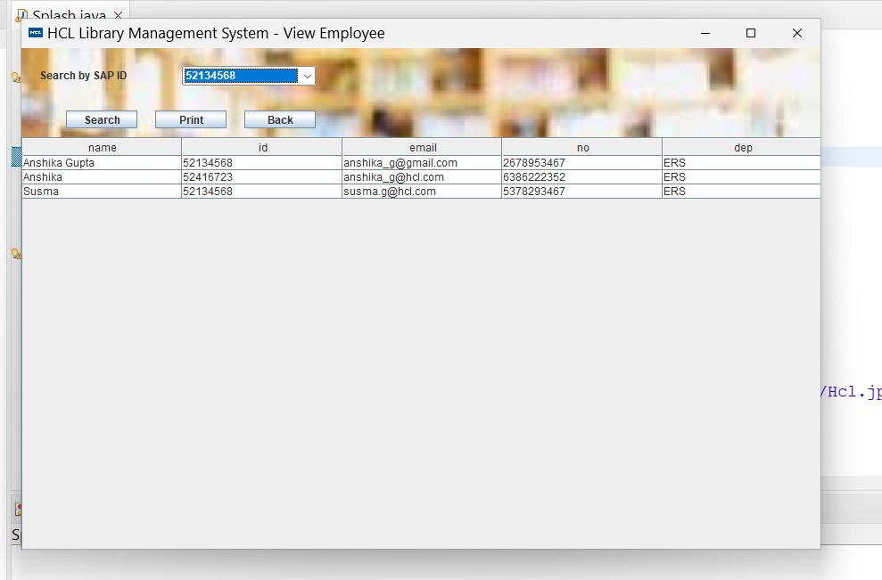
User Interface Modules
Java GUI-based application. – View Emp. Module
In this module we can search for the employees Details by their id from the org. database …

Slide 14
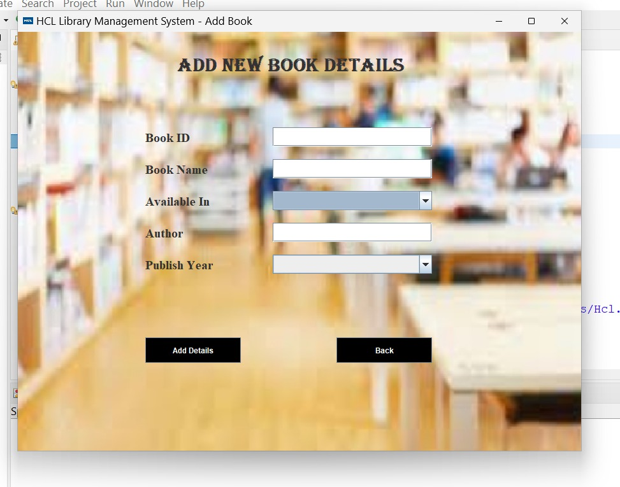
User Interface Modules
Java GUI-based application. –Add Book Module
In this module we Add Details of Book into the org. database …

Slide 15
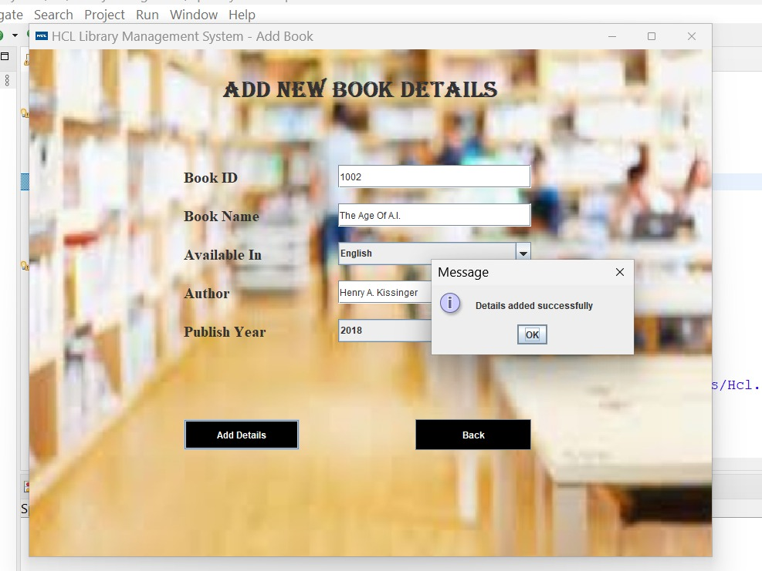
User Interface Modules
After Add the Book it pop ups a message that Details added successfully …

Slide 16
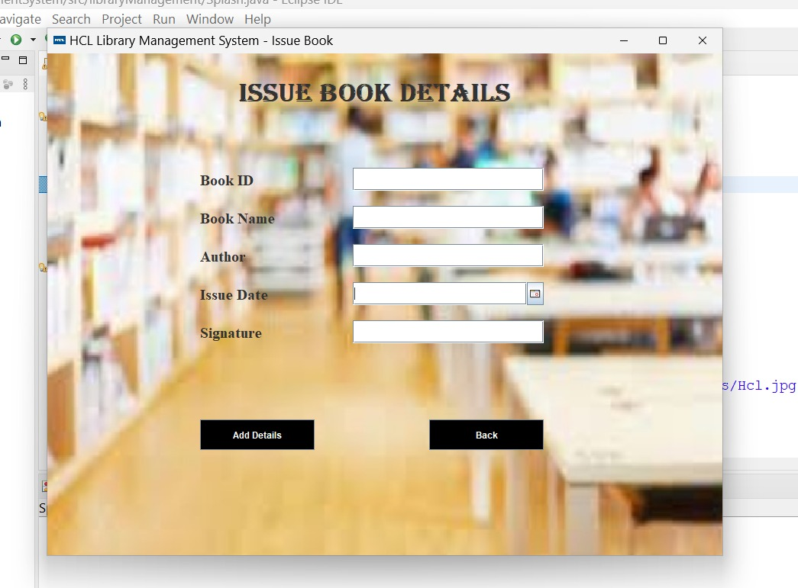
User Interface Modules
Java GUI-based application. – Issue Book Module
In this module we Issue Details of Book into the org. database …

Slide 17
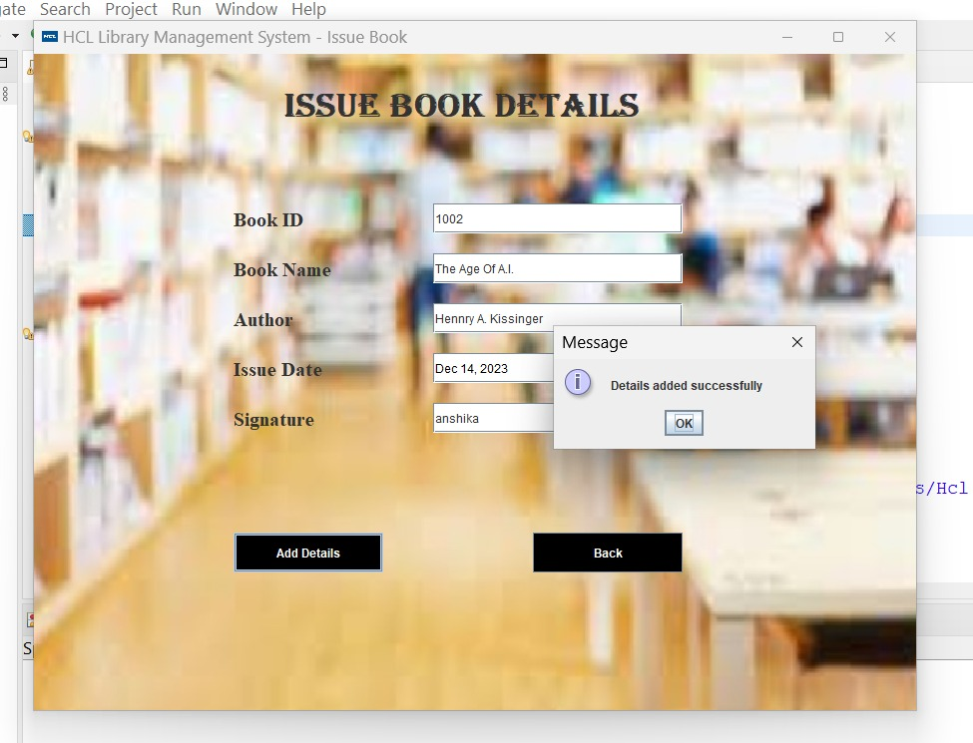
User Interface Modules
After Issue the Book it pop ups a message that Details added successfully …

Slide 18
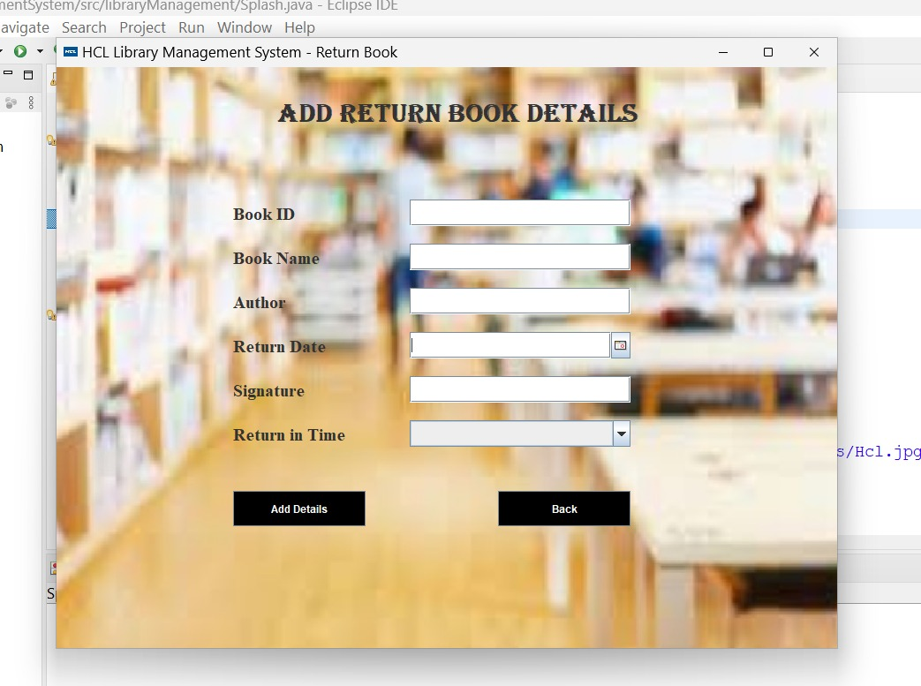
User Interface Modules
Java GUI-based application. – Add Return Book Module
In this module we Add Return Details of Book into the org. database …

Slide 19
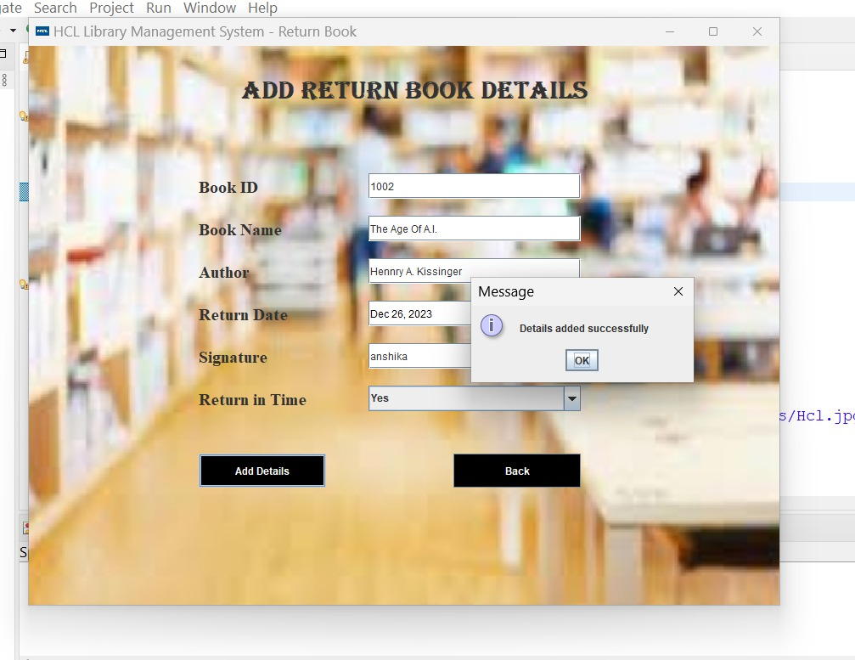
User Interface Modules
After Add Return the Book it pop ups a message that Details added successfully …

Slide 20
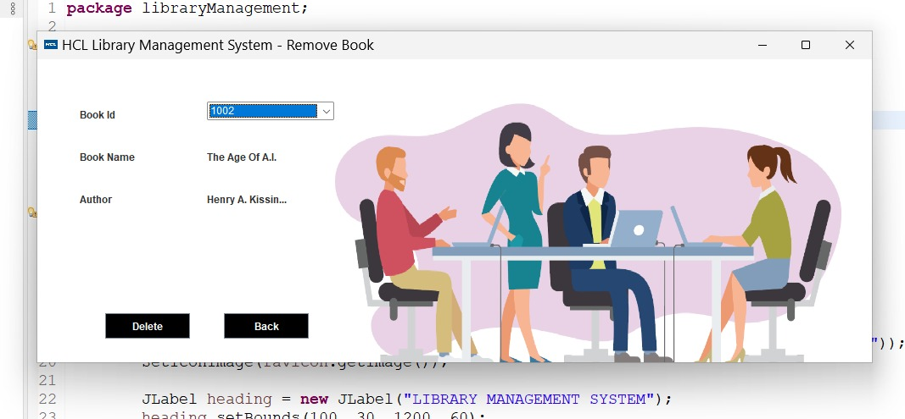
User Interface Modules
Java GUI-based application. – Remove Book Module
In this module we remove Details of Book from the org. database …

Slide 21
High Level Use Cases
Admin/Professionals will be able to manage the library and with the help of this Project.
Admin
Library Management System
(Application)
Input
Database
(Query will run according to the input provided)
Output
(come from the database results)

Slide 22
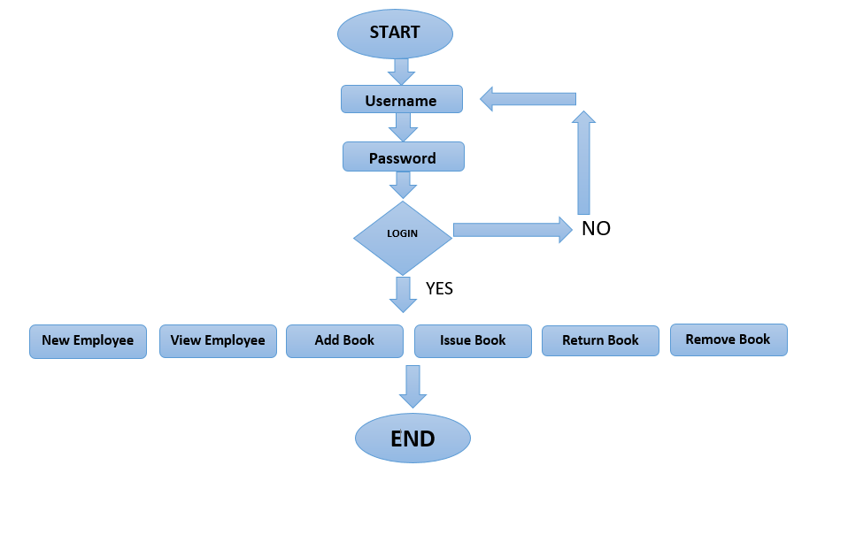
Workflow Diagram
YES

Slide 23
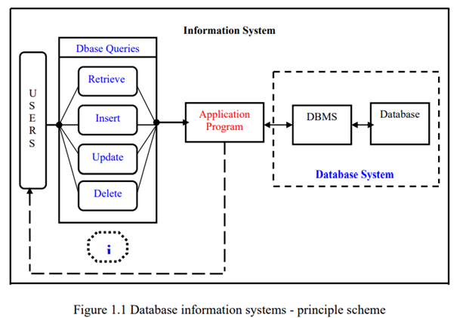
Database JDBC Diagram

Slide 24
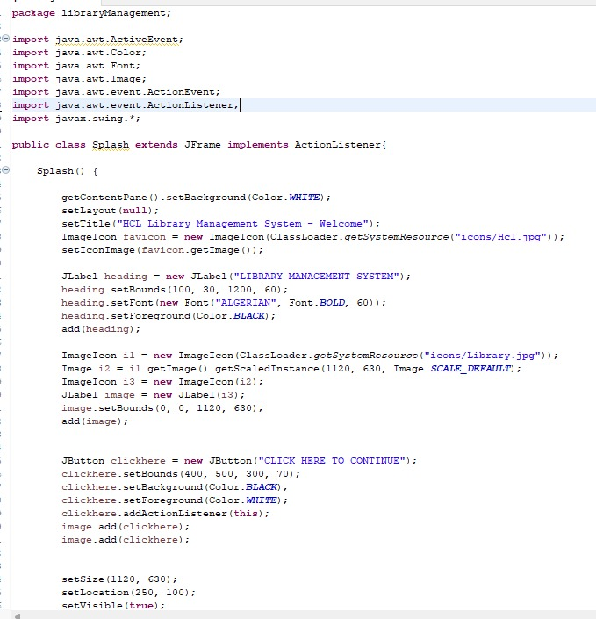
Source code (Splash class)

Slide 25


Slide 26
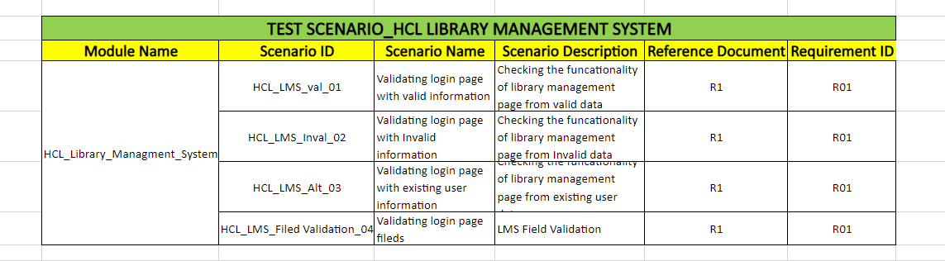
Test Scenario

Slide 27
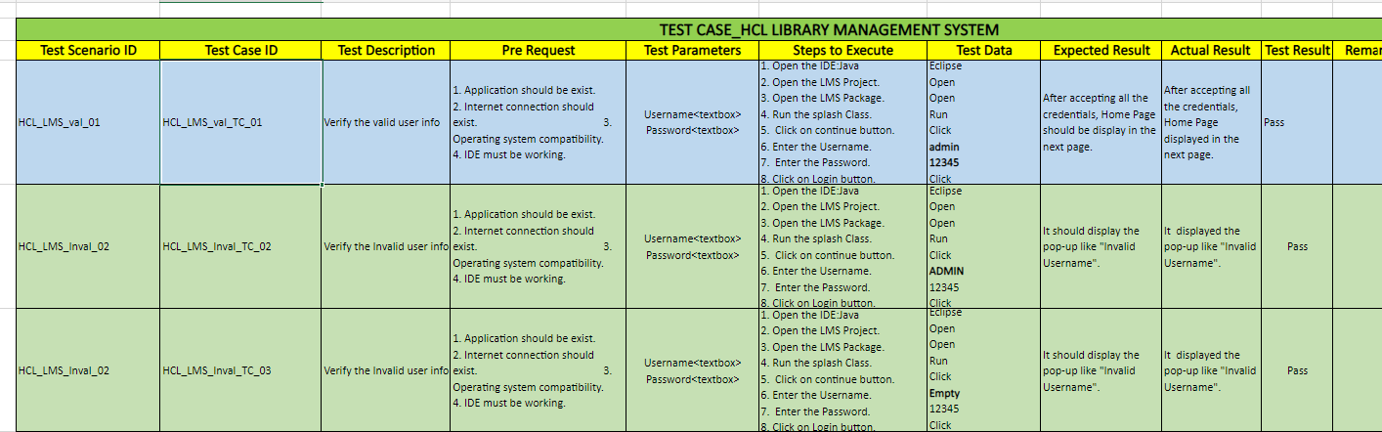
Test cases

Slide 28
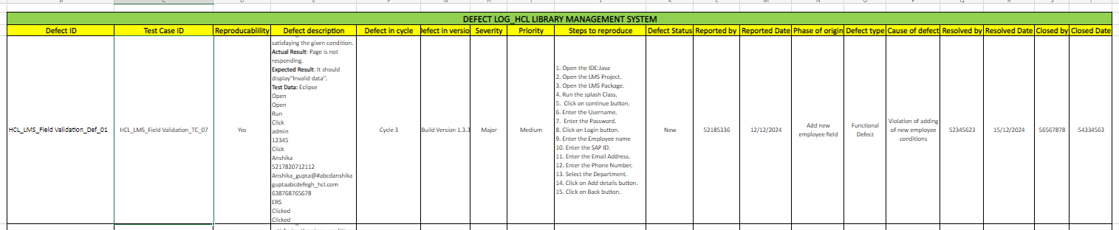
Defect log

Slide 29
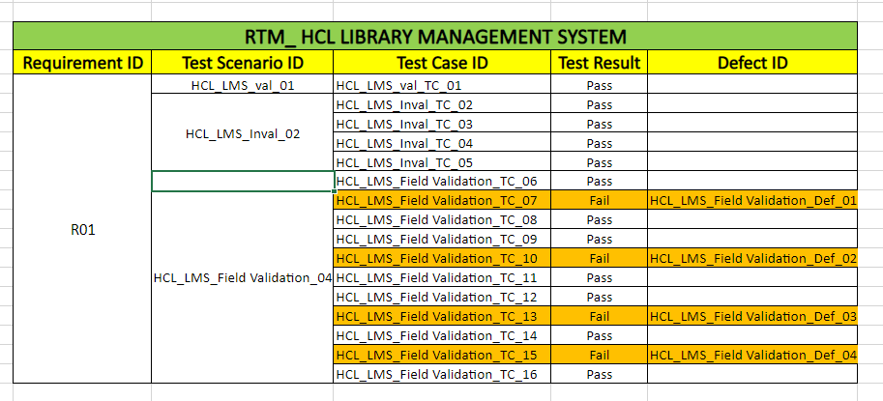
RTM

Slide 30


Slide 31
Test objective
The purpose of this document is to create an application test plan for a Library Management System.
The purpose of testing this program is to check the correct operations that undergo while using the program.

Slide 32
Scope of Testing
Within the scope:
Verifying operations like adding, returning, viewing and deleting the information is correctly performed by the program.
Out of scope:
Hardware interface

Slide 33

Test Strategies
Levels of testing
Types of testing
Test Design techniqe
Configuration management tool
Terminology

Slide 34

Automation Testing on NopCommerce using selenium and TestNG

Slide 35
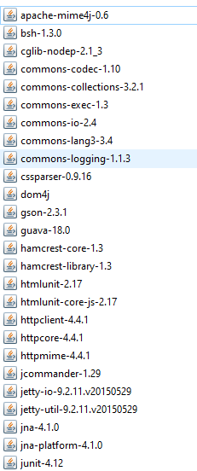
Important jars for automation Testing
All the jars are in project link.

Slide 36
Cross-Browser Testing

Slide 37
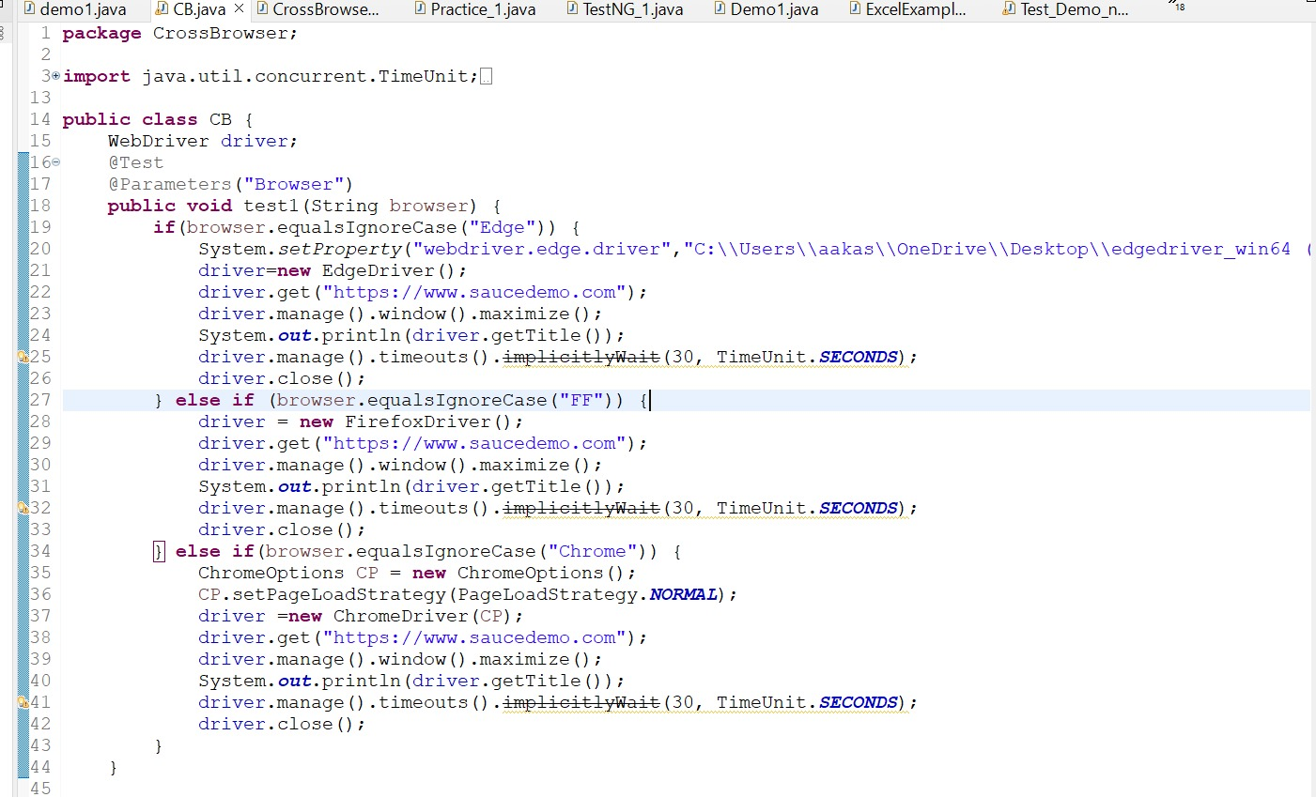
Validating Sign-up. (by cross-browser testing on Swag Labs)

Slide 38
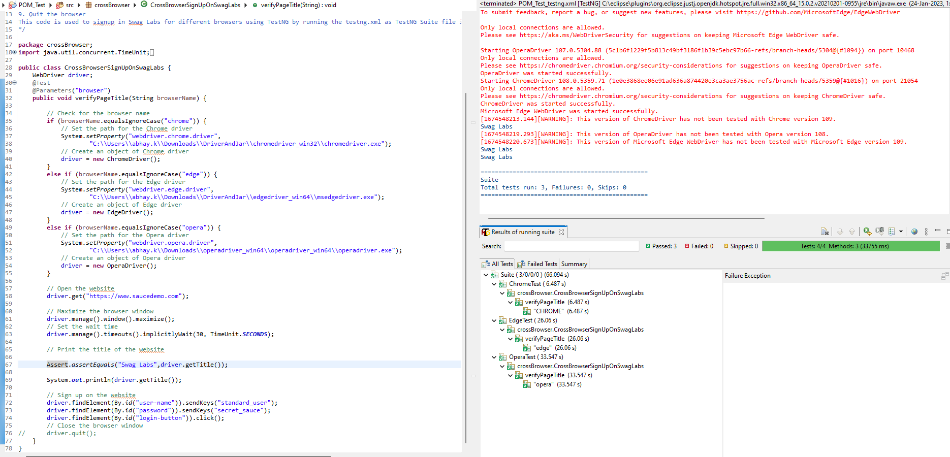
Test Result Of Cross Browser Testing

Slide 39
Data Driven Testing

Slide 40
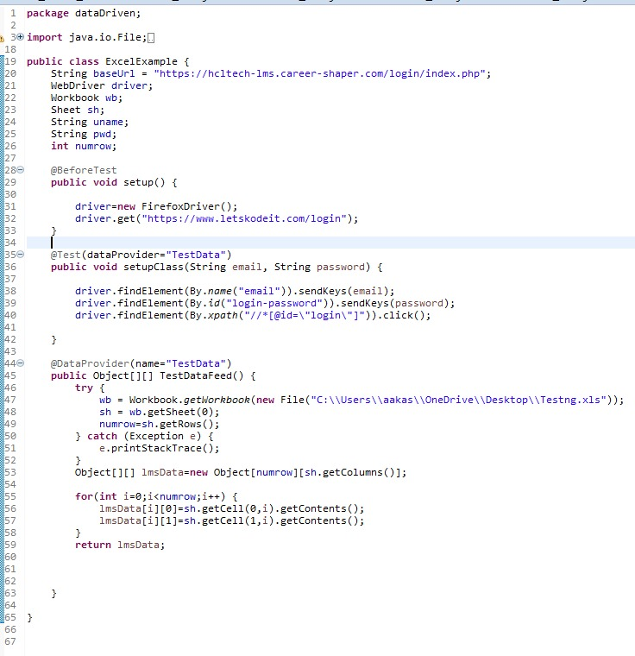
Class_1

Slide 41

Automating an E- commerce website By Page Object Model

Slide 42

Page Object Model without Browser Factory

Slide 43
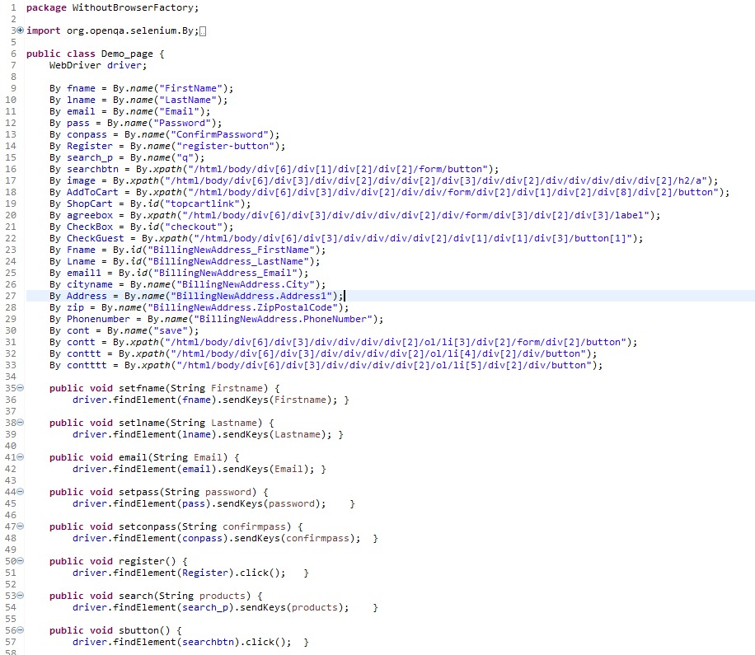
Class 1

Slide 44
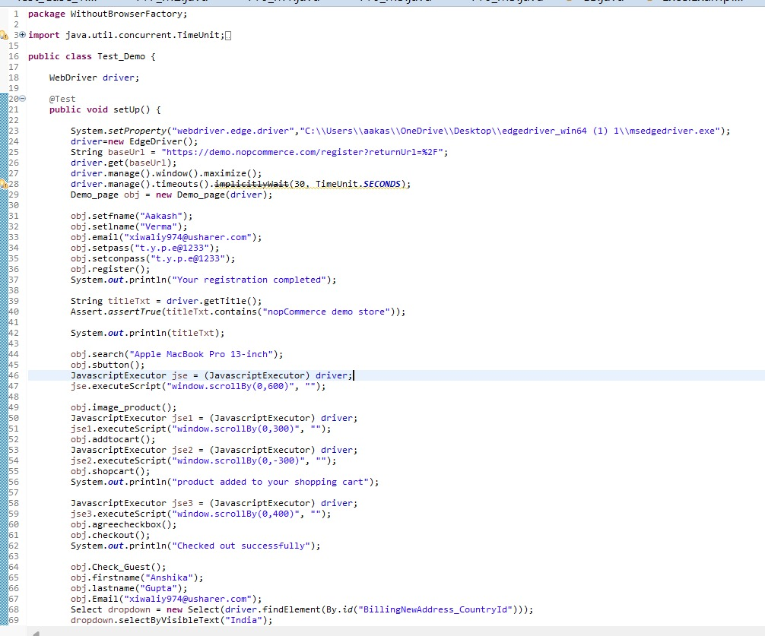
Class 2

Slide 45
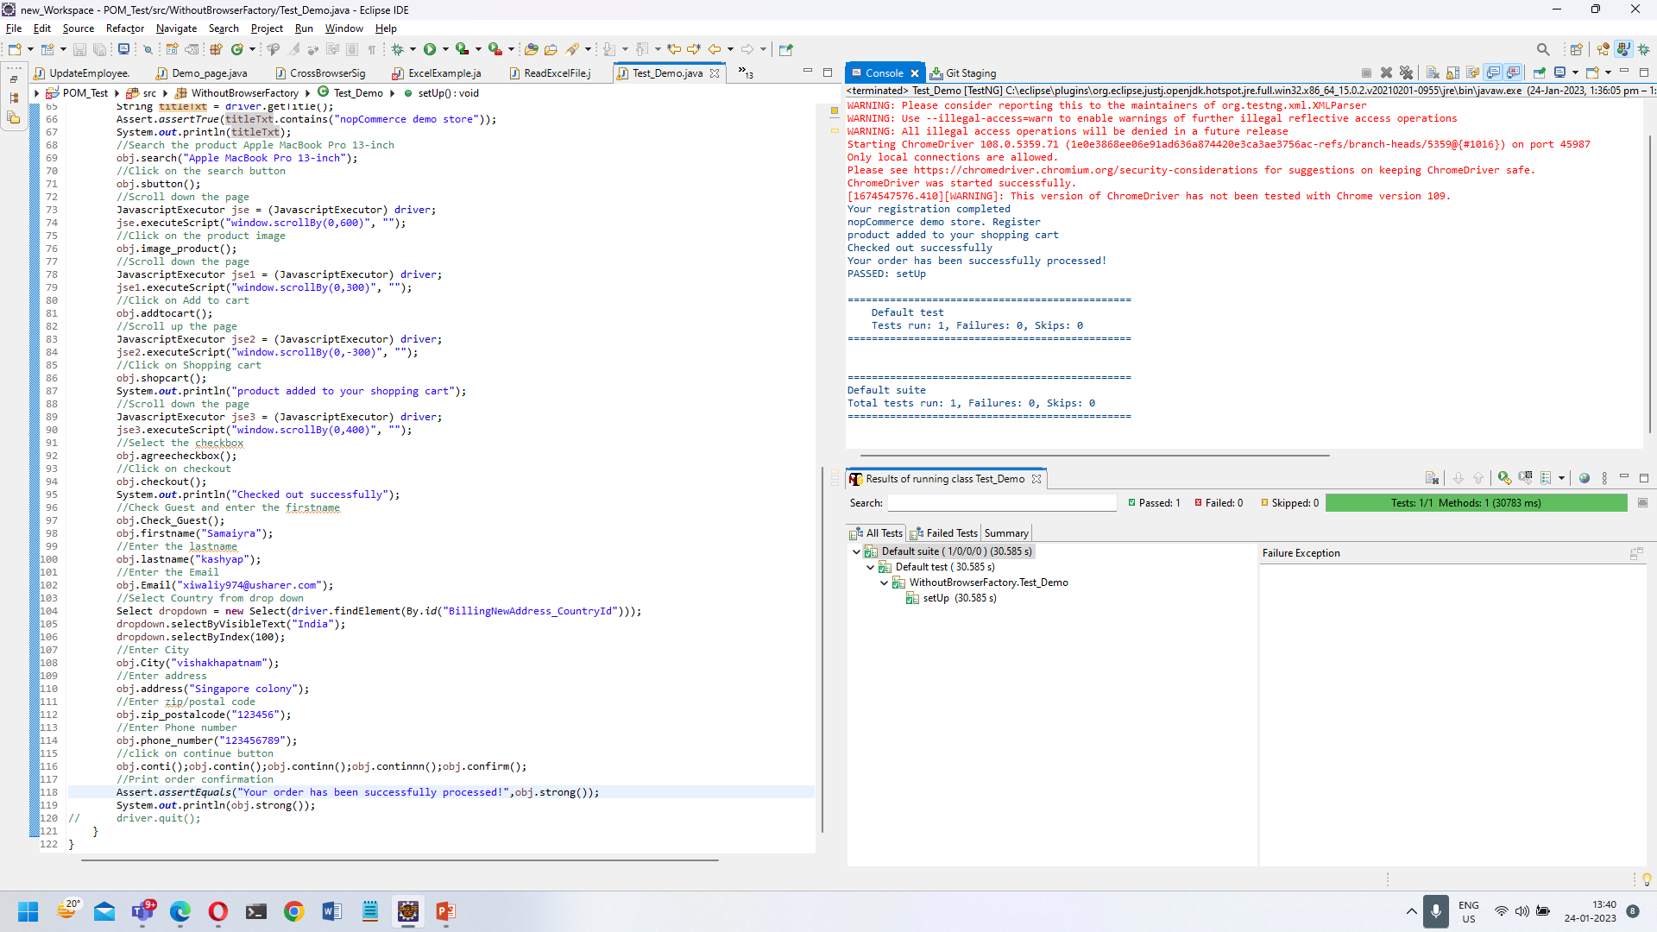
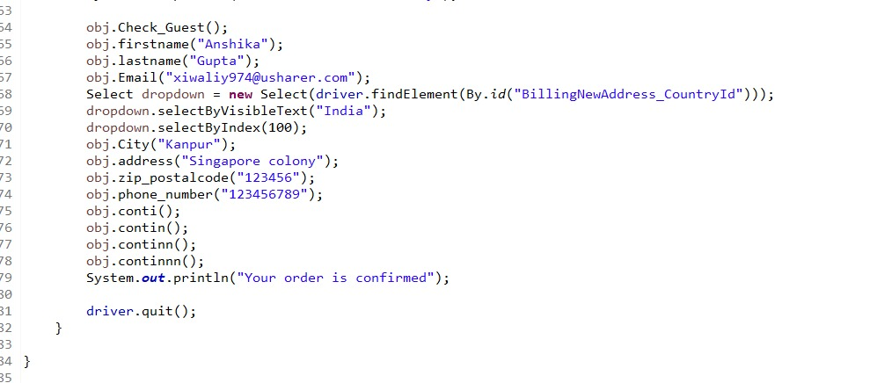
Class 2 (contd.) with Test results

Slide 46
Page Object Model with Browser Factory

Slide 47
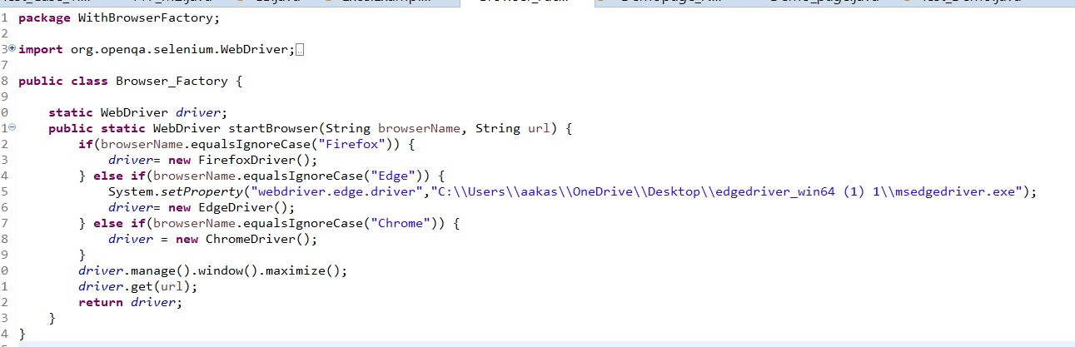
Class 1 (Browser_Factory)

Slide 48
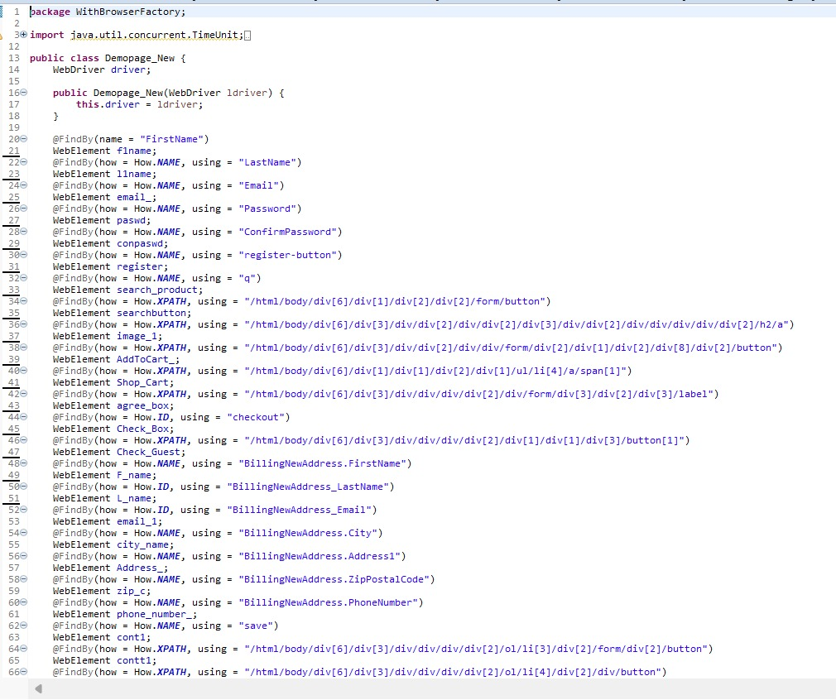
Class 2

Slide 49
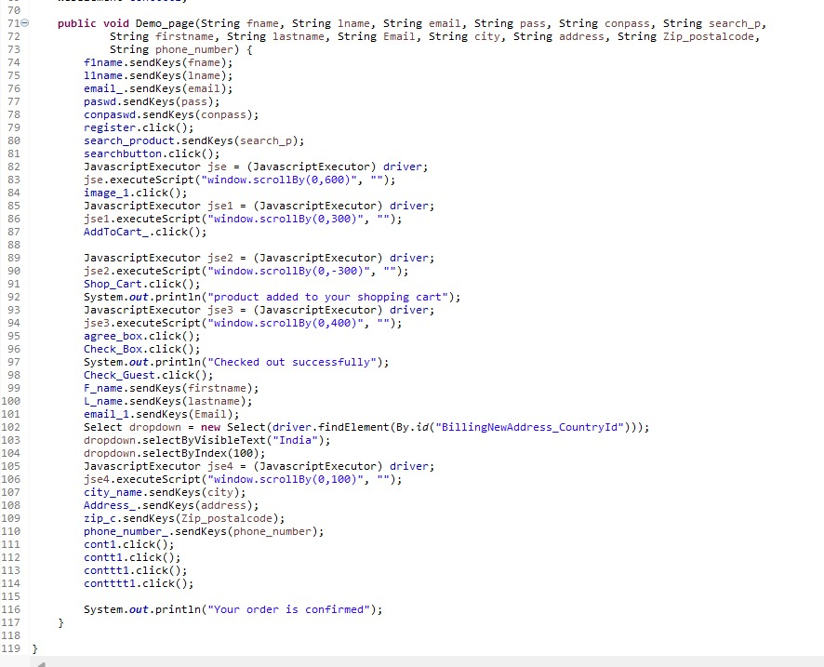
Class 2 (contd..)

Slide 50
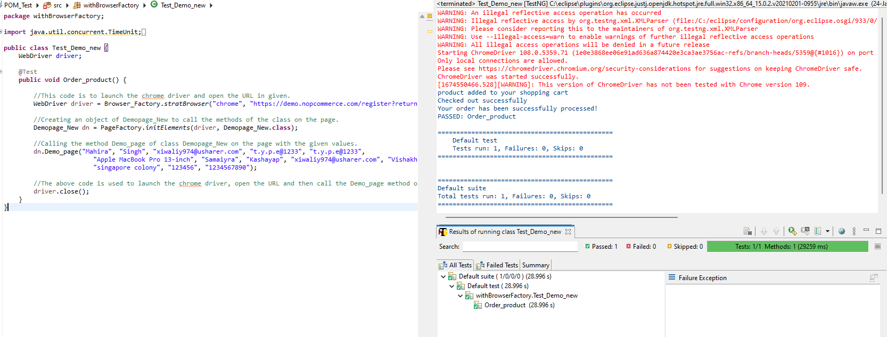
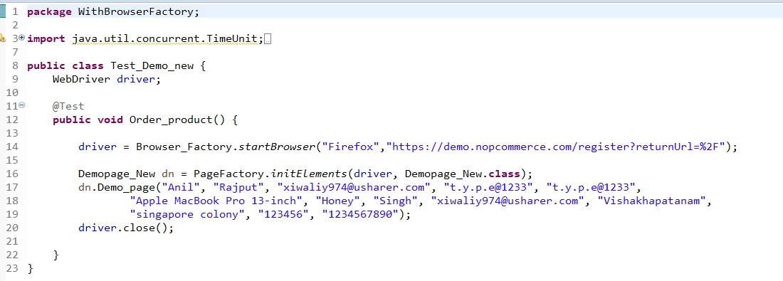
Class 3

Slide 51
Important Link for this Project
Click here to get All the full fledged source codes mentioned in the project
Or Simply you can just copy paste the link below if above link doesn’t open:
https://github.com/aakash-646/CRT-Project

Slide 52
Thank you

